Slide 1
Data Mining 2 Supervised Learning
CLASSIFICATION 2
Dr. Shailesh Kumar
ISB

Slide 2
From Data to Decisions…
Insights
Features
Domain Knowledge
Models
Data
Predictions
Decision
Business Objectives
Business Constraints
Feedback

Slide 3
K-Nearest Neighbor Non-Parametric Classifier

Slide 4
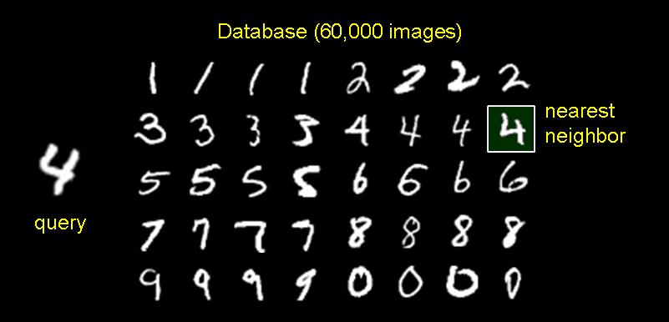
1-Nearest Neighbor Classifier
Training Examples (Instances)
Some for each CLASS
Test Examples
(What class to assign this?)

Slide 5
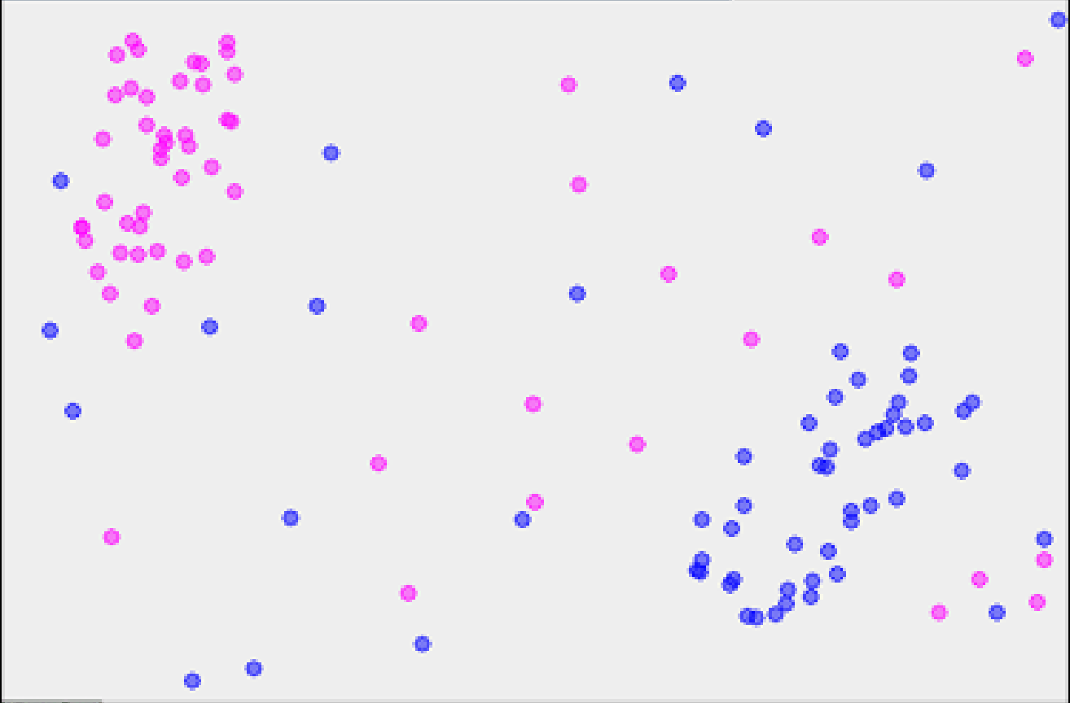
1-Nearest Neighbor
x
http://www.math.le.ac.uk/people/ag153/homepage/KNN/OliverKNN_Talk.pdf

Slide 6
2-Nearest Neighbor
?

Slide 7
3-Nearest Neighbor
X

Slide 8
8-Nearest Neighbor
X

Slide 9
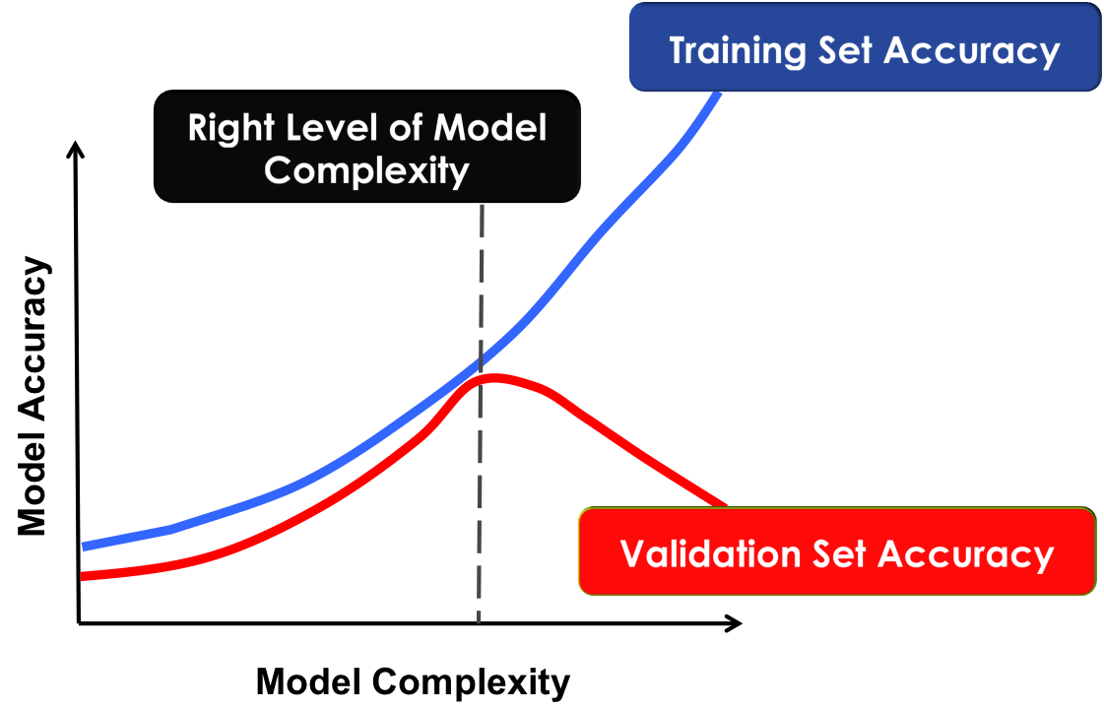
Controlling COMPLEXITY in k-NN

Slide 10
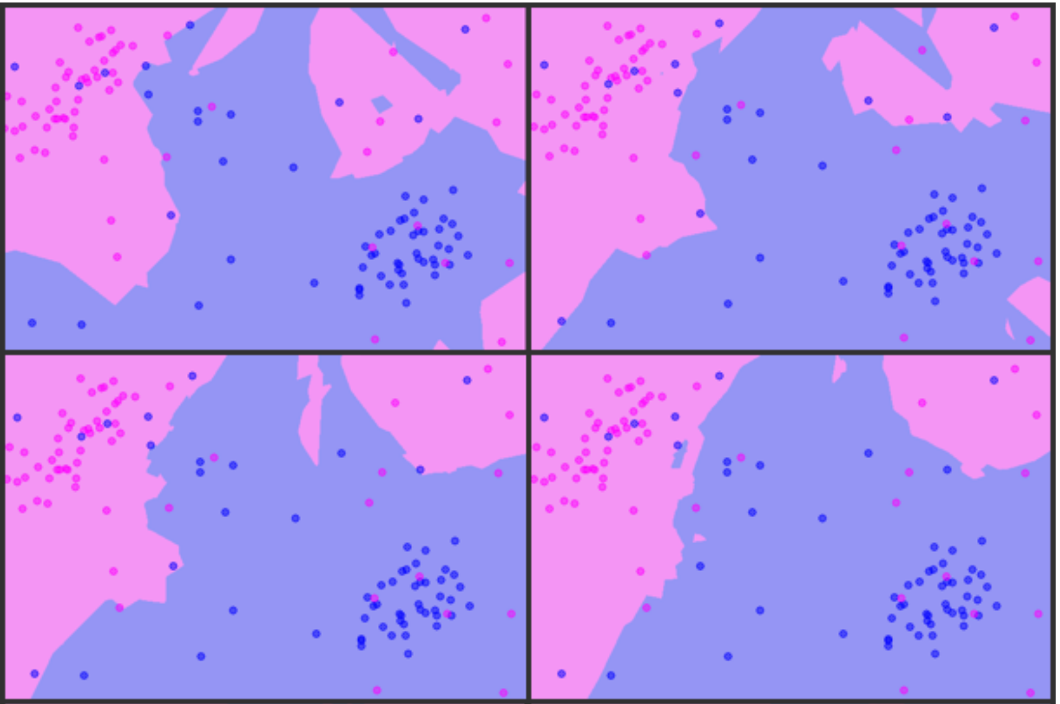
K = 3, 5, 7, 9

Slide 11
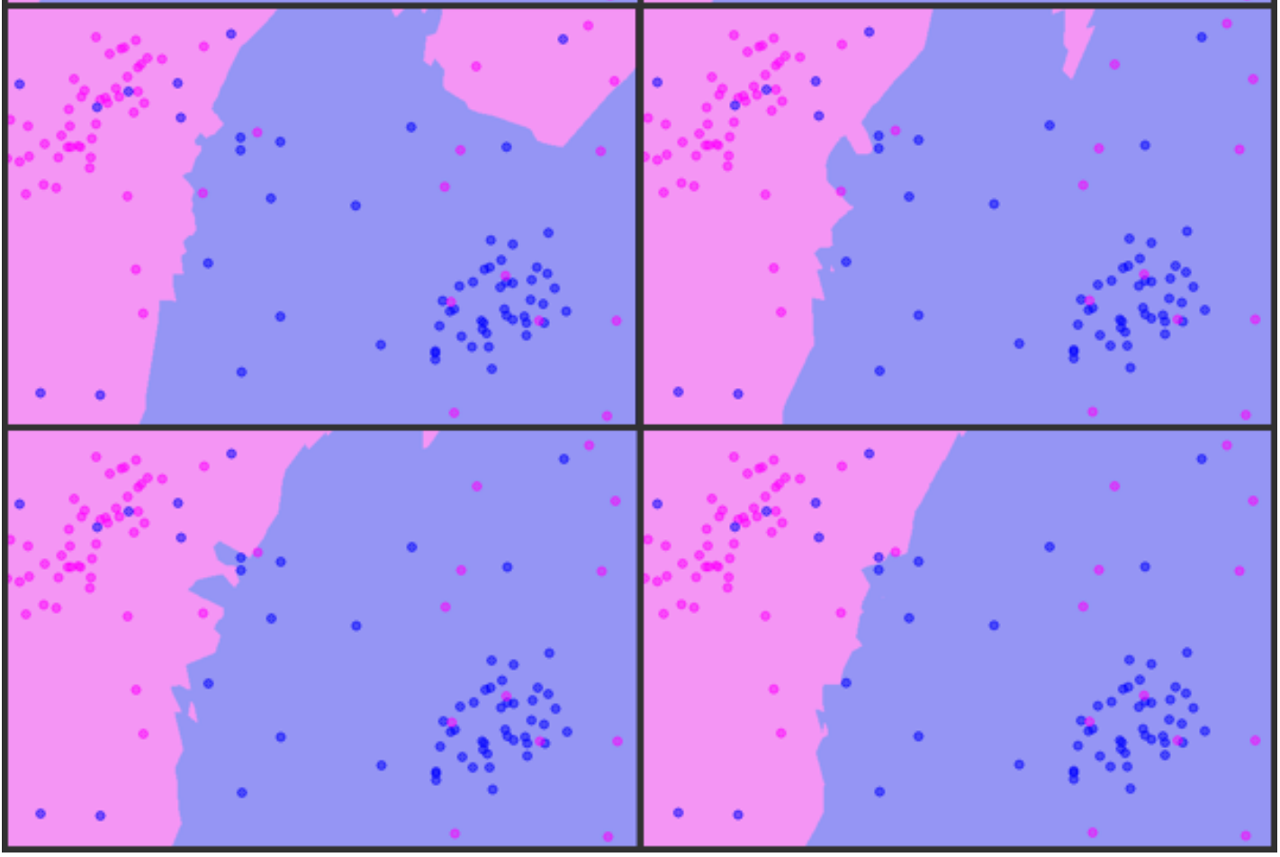
K = 11,13,15,17

Slide 12
K-Nearest Neighbor Classifier
What are the PARAMETERS?
What’s the TRAINING TIME?
What’s the SCORING COMPLEXITY?
Distance / Similarity function is the key
Choosing K
Even K could lead to confusion – breaking the tie
K = 1, 3, 5, 7, 9, …
Higher the Noise in the data, more K is better!
Better Lookup times using KD-Trees and other tricks!
Brittle in presence of noisy data
Loosing the actual distance value

Slide 13
Parzen Window Classifier Kernel Density Function

Slide 14
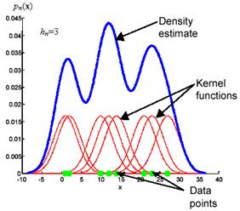
Kernel Density Function
https://www.byclb.com/TR/Tutorials/neural_networks/ch11_1.htm

Slide 15
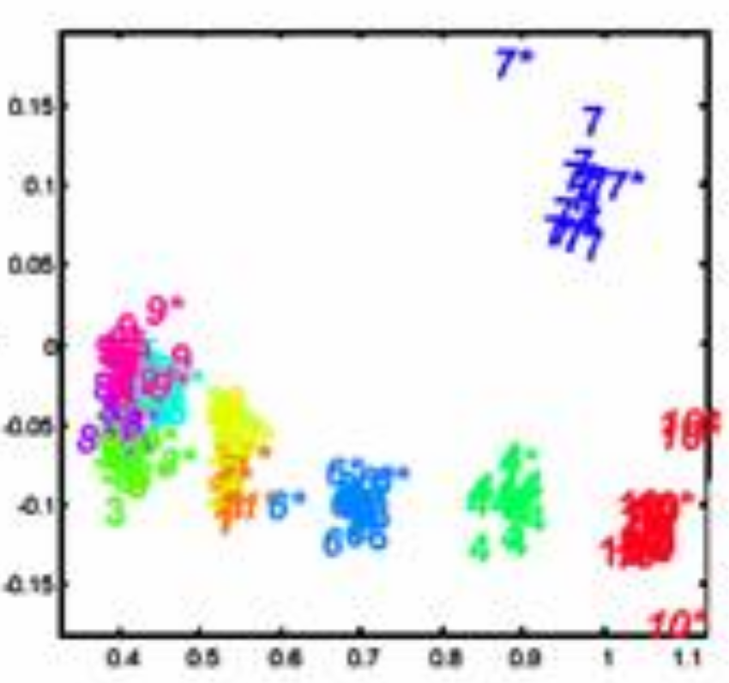
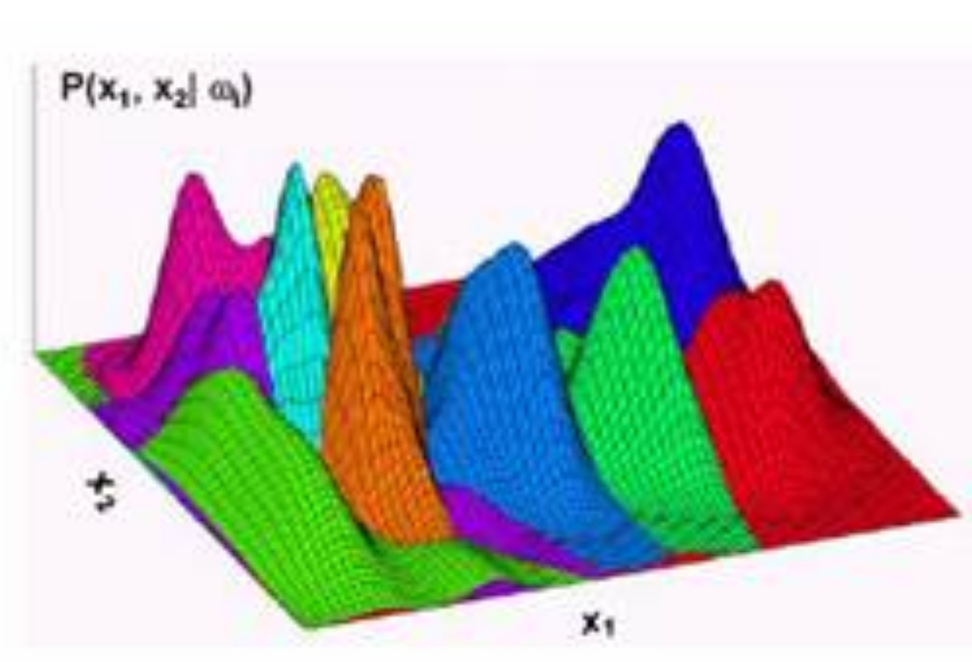
Parzen Window Classifier

Slide 16
Controlling COMPLEXITY in PW

Slide 17
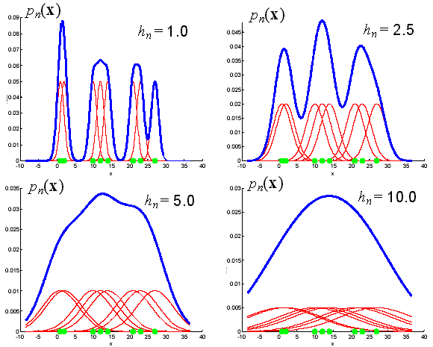
Choice of Window Size

Slide 18
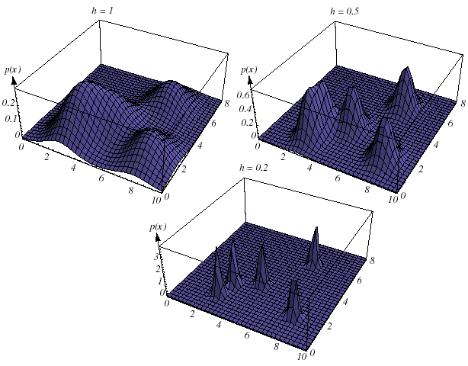
Choice of Window Size (2-D)

Slide 19
Bayesian Thinking

Slide 20
Bayes Rule
Symmetry of Joint vs. Conditional probability:
Bayes Rule: The most important Equation in ML!!
Class Prior
Data Likelihood given Class
Data Prior (Marginal)
Posterior Probability
(Probability of class AFTER seeing the data)

Slide 21
MAP vs. ML estimation
Maximum Likelihood Decision
Maximum Aposteriori Probability decision

Slide 22
Thinking Like a Bayesian!
A patient takes a lab test for cancer which gives:
And, only 0.8% of the entire population has cancer.
Correct positive result 95% of the times.
Correct negative result 90% of the times.

Slide 23
Thinking Like a Bayesian
What is the prior probability that test is positive?
What is the prior probability that the test is negative?

Slide 24
Thinking like a Bayesian
What is probability of cancer if test is positive?
What is probability of cancer if test is negative?

Slide 25
Bayesian Classifier Multi-variate, Real-valued

Slide 26
Bayes Rule
Class Prior
Data Likelihood given Class
Data Prior (Marginal)
Posterior Probability
(Probability of class AFTER seeing the data)

Slide 27
Simple Bayesian Classifier
Each Class Conditional Probability is assumed to be a Uni-Modal (Single Cloud) (NORMAL) Distribution

Slide 28
Controlling COMPLEXITY

Slide 29
Spherical-SAME Covariance/Class
Euclidian Distance

Slide 30
Spherical-DIFFERENT Covariance/Class
Class Scaled Euclidian Distance

Slide 31
Independent Covariance/Class
Class/Dim. Scaled Euclidian Distance

Slide 32
FULL Covariance/Class
Mahalanobis Distance

Slide 33
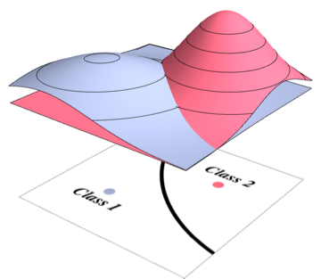
Bayesian Classifier Decision Boundary
Class Cond. Density!
Decision Boundary!

Slide 34
LDA vs. QDA
LINEAR Discriminant Analysis
QUADRATIC Discriminant Analysis
$$Σ_{1}=Σ_{2}$$
$$Σ_{1}≠Σ_{2}$$

Slide 35
Bayesian Classifier Mixture-of-Gaussians

Slide 36
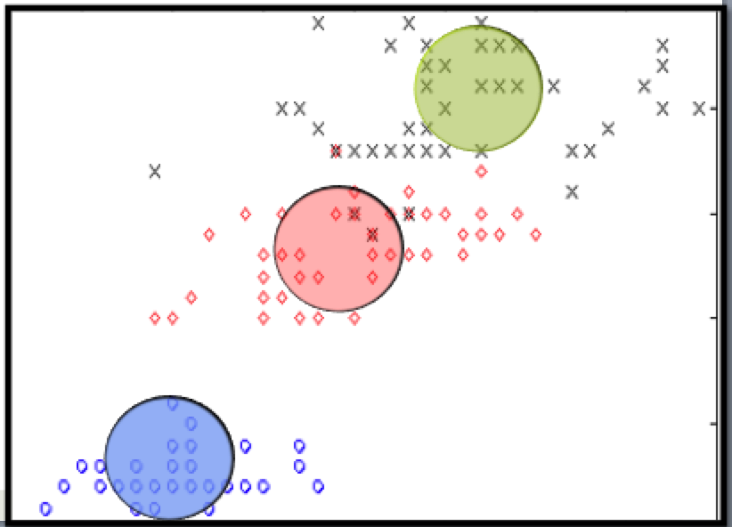
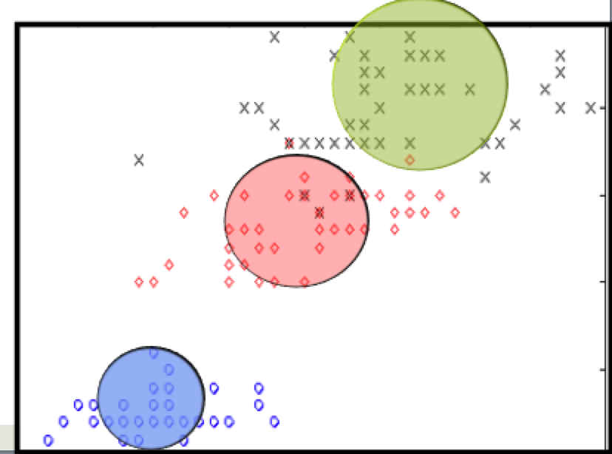
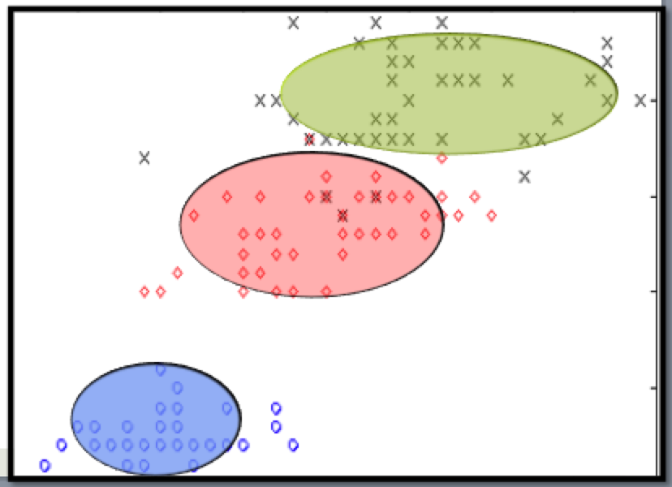
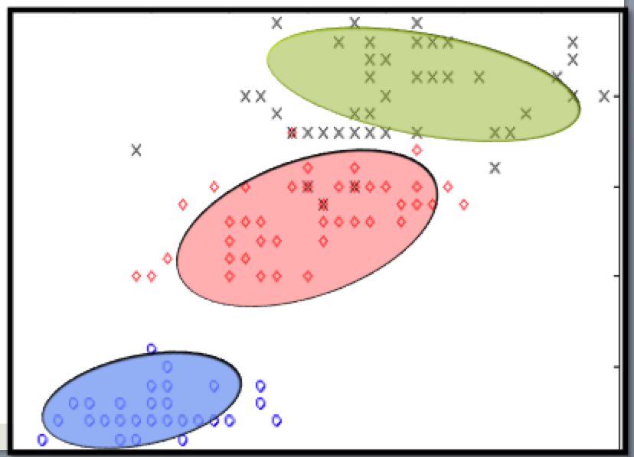

Slide 37
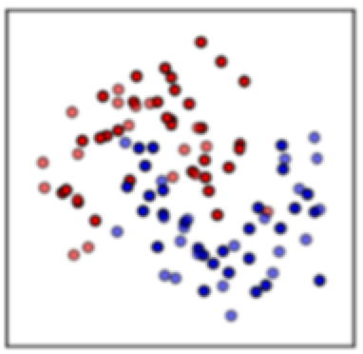
3-degrees of Complexity
FEATURE DEPENDENCE
MODALITY OF DENSITY FUNCTION
CLASS

Slide 38
Mixture of Gaussians
Uni-Modal
Multi-Model (Mixture-of-Gaussians)

Slide 39
Mixture of Gaussians

Slide 40
Clustering → Density Estimation
Mean + Covariance
Uni-Modal
Mixture of Gaussians
Parzen Window
Mean Only
Mean
K-Means Clustering
1-Nearest Neighbor

